Slide 1




Occupancy modeling
Introduction to their use and application in ecology and epidemiology
f.rasambainarivo@gmail.com
f.rasambainarivo@gmail.com
Fidisoa Rasambainarivo, DVM, MSc, PhD
Mahaliana Labs
www.mahaliana.org
@Fidydvm
@Fidydvm
www.fidyras.wordpress.com
www.fidyras.wordpress.com

Slide 2

Occupancy model: lecture and tutorial objectives
- Understand what are occupancy models
- Why would we use occupancy models
- How to design a study using occupancy modeling
- Working example:
Prevalence of a parasite in a population with imperfect test.
Overview of other use of occupancy models

Slide 3
Why?
Abundance and distribution in ecology
Used to assess/re-assess population trends

Slide 4
Why?
Abundance and distribution in ecology
Used to assess/re-assess population trends
Often very difficult to know abundance
Capture Mark Recapture…

Slide 5
Why?
Abundance and distribution in ecology
Used to assess/re-assess population trends
Often very difficult to know abundance
Expensive (CMR…)
Sometimes presence/absence is just what we need…
Distribution and range
Animal invasions
Disease dynamics

Slide 6
Why?
Abundance and distribution in ecology
Used to assess/re-assess population trends
Often very difficult to know abundance
Expensive (CMR…)
Sometimes presence/absence is just what we need…
Distribution and range
Animal invasions
Disease dynamics
Occupancy modeling: a tool to estimate true populations and monitor changes
But what do I mean by occupancy?

Slide 7
What is occupancy?
Probability that focal object (taxon) occupies or uses a sample unit during a specified period of time.
ψ = x/s
x = number of occupied sites
s = total number of sites

Slide 8
What is occupancy?
Probability that focal object (taxon) occupies or uses a sample unit during a specified period of time.
Within disease ecology/epidemiology framework : what is the probability that a parasite is found in an individual ie. what is the prevalence of the disease in a population?
Prevalence = Number of infected/population

Slide 9
What is occupancy?
Probability that focal object (taxon) occupies or uses a sample unit.
Taxon is said to be present if:
Taxon is present
AND
Taxon is detected

Slide 10
What is occupancy?
Probability that focal object (taxon) occupies or uses a sample unit.
Taxon is said to be present if:
Taxon is present
AND
Taxon is detected
What does absence data tell us?
Taxon is absent
OR
Taxon was not detected by investigator

Slide 11
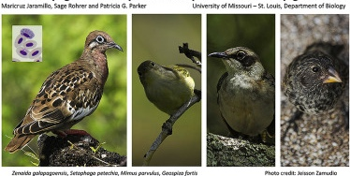
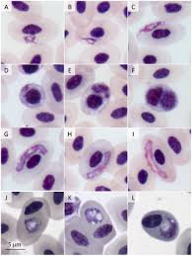
estimate disease prevalence
For example:
Researchers want to know the prevalence of Plasmodium sp. in birds of Galapagos?

Slide 12
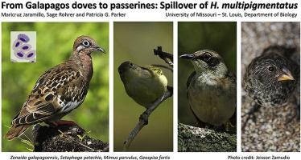

estimate disease prevalence
Example:
Researchers want to know the prevalence of Plasmodium in sampled birds of Galapagos?
Collect a biological sample from each individual in a sample population and test it once to determine the presence of the parasite in the sample.
Yes/No
x% (95% CI)
Notes:
What is the major assumption here?

Slide 13
estimate disease prevalence
Example:
Researchers want to know the prevalence of Plasmodium in sampled birds of Galapagos?
Collect a sample from each individual once and test it once to determine the presence of the parasite in the sample.
Yes/No
X%
Assuming that test is perfect and probability of detection is 100% in infected individuals (sensitivity of test is 100%)

Slide 14

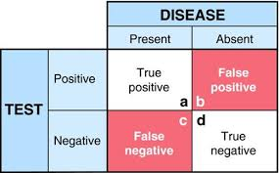
estimate disease prevalence
Reality:
Most tests are imperfect
Result in occupancy/prevalence estimates that are biased low
Underestimation of pathogen transmission rates
Flawed predictions regarding infection dynamics and epidemic spread.

Slide 15
estimate disease prevalence
Reality:
Most tests are imperfect
Result in occupancy/prevalence estimates that are biased low
Underestimation of pathogen transmission rates
Flawed predictions regarding infection dynamics and epidemic spread.
Need to correct
Comparison of used test with a reference test
Several diagnostic methods need to be available.

Slide 16
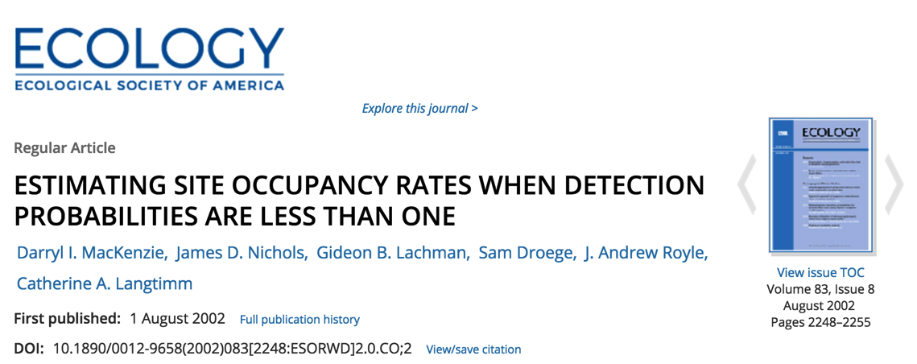
Occupancy models
To estimate the proportion of all ‘sites’ that are occupied by the taxon, with the explicit recognition that the taxon may be missed even if present during a survey.

Slide 17
Occupancy models
Estimated parameters and notation
Probability that taxon is present at a site = Proportion of occupied sites = Occupancy (ψ Psi) = prevalence

Slide 18
Occupancy models
Estimated parameters and notation
Probability that it is detected when present (p) = detection probability during survey = sensitivity of test
Probability that taxon is present = Occupancy (Psi) = prevalence

Slide 19
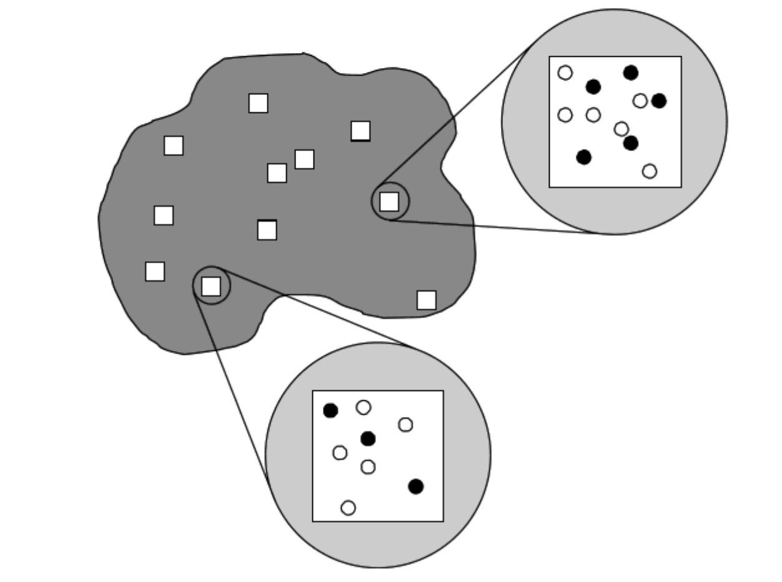
How do I design a study to use Occupancy models
Key is replicates:
Spatial: multiple sites site : basic landscape unit at which the presence of the taxon is determined. Could be naturally occurring (pond, patch, etc…) or not

Slide 20
How do I design a study to use Occupancy models
Key is replicates:
Spatial: multiple sites site : basic landscape unit at which the presence of the taxon is determined. Could be naturally occurring (pond, patch, etc…) or not
Temporal: multiple visits to each site survey: a single opportunity for the detection of target species

Slide 21
Occupancy models: under the hood
- Record of whether a species was detected or not detected during each survey of each site (detection histories)
- Probability of a specific detection history e.g. 111, 011 or 000
Maximum likelihood techniques are used to estimate parameters.

Slide 22
Occupancy models: under the hood
Example (1) survey 30 sites 4 times
We can write the probability of this detection history as:
Pr(Hi = 1001) = ψ × p1 (1 – p2 )(1 – p3 ) p4
 | Survey 1 | Survey 2 | Survey 3 | Survey 4
Site 1 | 1 | 0 | 0 | 1

Slide 23
Occupancy models: under the hood
Sites 2 and 30 represent a case where the target species was never detected (detection history = 0000)
 | Survey 1 | Survey 2 | Survey 3 | Survey 4
Site 2 | 0 | 0 | 0 | 0
Site ..30 | 0 | 0 | 0 | 0

Slide 24
Occupancy models: under the hood
Sites 2 and 30 represent a case where the target species was never detected (detection history = 0000)
These sites could either be unoccupied, which mathematically is (1-ψ),
or they could be occupied, but we never detected the target species, which mathematically is:
ψ(1- p1 )(1- p2 )(1- p3 )(1- p4 ) or ψΠ 4 j=1 (1 – pj )
Thus, we can write the probability of detection history (0000) as: Pr(H i = 0000) = ψΠ 4 j=1 (1 – pj ) + (1-ψ)
 | Survey 1 | Survey 2 | Survey 3 | Survey 4
Site 2 | 0 | 0 | 0 | 0
Site ..30 | 0 | 0 | 0 | 0

Slide 25
Occupancy models: under the hood
Mathematical statements of all detection histories are combined into model likelihood, such as:
L(ψ, p H 1 ,…, H 30) =Π 30 i=1 Pr(Hi )
Product of math equations forms the model likelihood for the observed data
Using MLE determine Psi and p

Slide 26
Occupancy models
Assumptions:
(1): Site is “closed”: species presence does not change during a sampling season (but can change between seasons- “multiple season”)

Slide 27
Occupancy models
Assumptions:
(1): Site is “closed”: species presence does not change during a sampling season (but can change between seasons- “multiple season”)
(2): Sites are independent: detection of species at one site is independent from detection at another site.

Slide 28
Occupancy models
Assumptions:
(1): Site is “closed”: species presence does not change during a sampling season (but can change between seasons- “multiple season”)
(2): Sites are independent: detection of species at one site is independent from detection at another site.
(3): No false detection

Slide 29

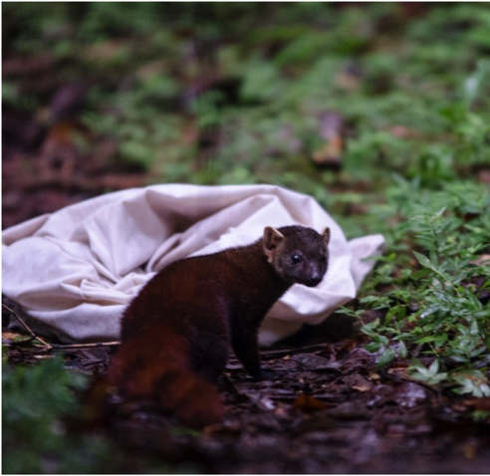
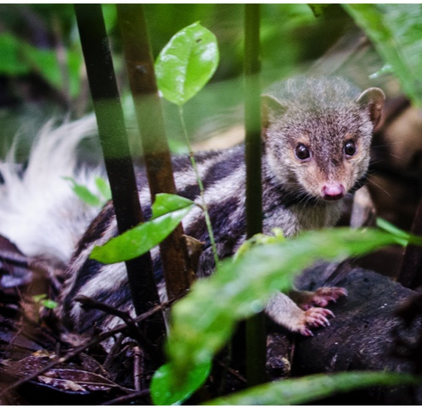
Enough talk: Working example
Start up your Rstudio
Working example:
Researchers want to know :
What is the prevalence of antibodies to Toxoplasma in sampled galidinae of Madagascar given imperfect test?
Does Sex, Age, Weight influence the infection and detection of parasite in this species of Madagascar?

Slide 30
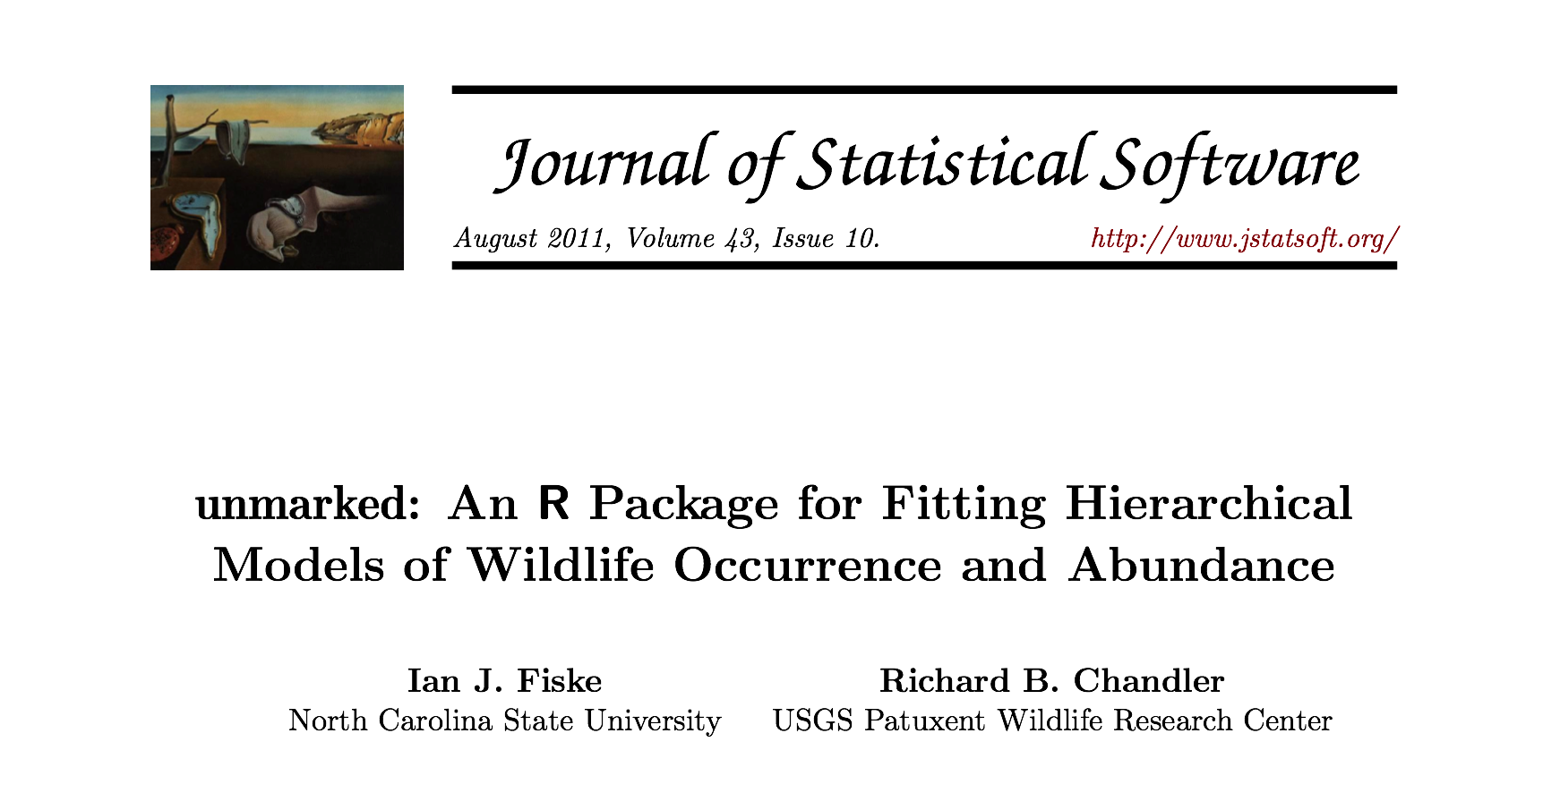
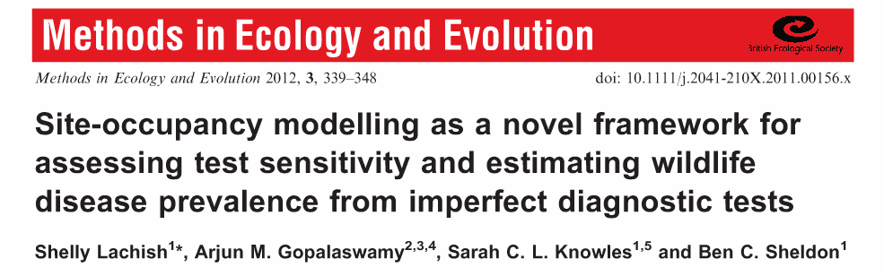
Enough talk: Working example

Slide 31
Occupancy dynamics: Beyond Single Season
ε – local extinction
γ – colonization
(1−ε) – not extinct
(1−γ) – not colonized
1 - occupied
1 - occupied
Occupancy state
0 - unoccupied
0 - unoccupied
season
Notes:
Changes in population size through time are a function of births, deaths, immigration, and emigration.
The open population CMR models we have considered until now have only estimated apparent survival rates.
That is, true survival, the portion of individuals surviving between sampling occasions is confounded with permanent emigration.
I spoke briefly on closed models that assume that size of the population remained unchanged between sampling events.
Robust design integrates the advantages of both types of models.
Although this model is complicated, it brings more biological reality to the analysis of population dynamics.
This method provides for the estimation of parameters that are not estimable under either open or closed models as well as more robust estimates of the familiar parameters of interest.

Slide 32
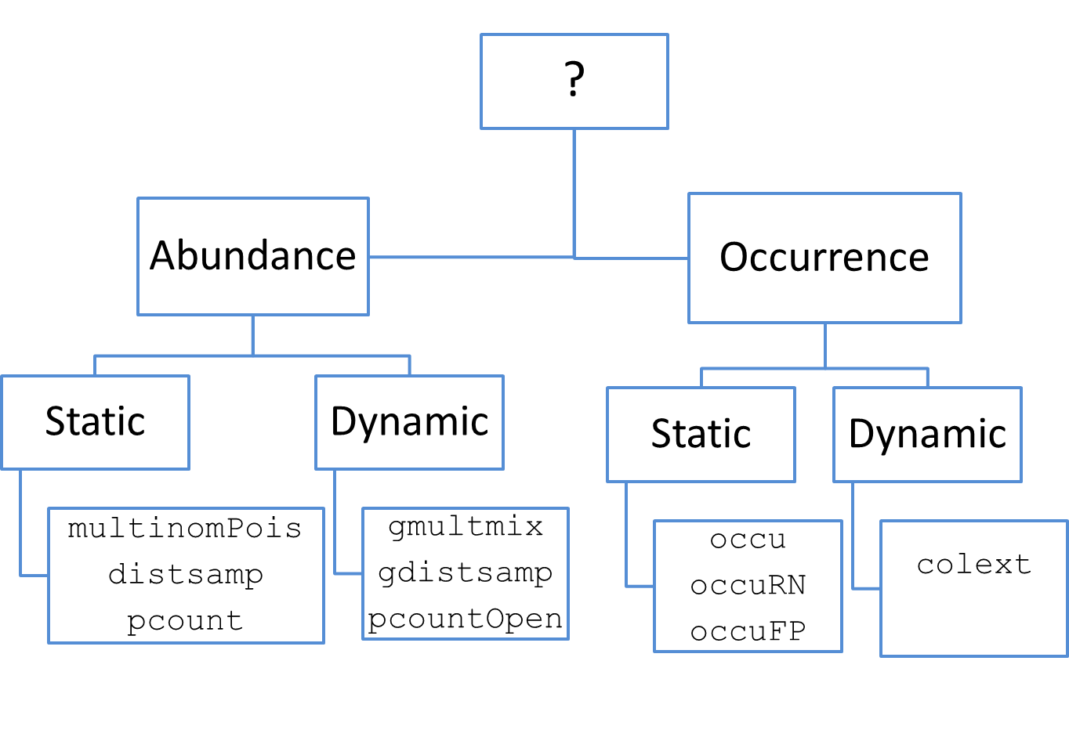
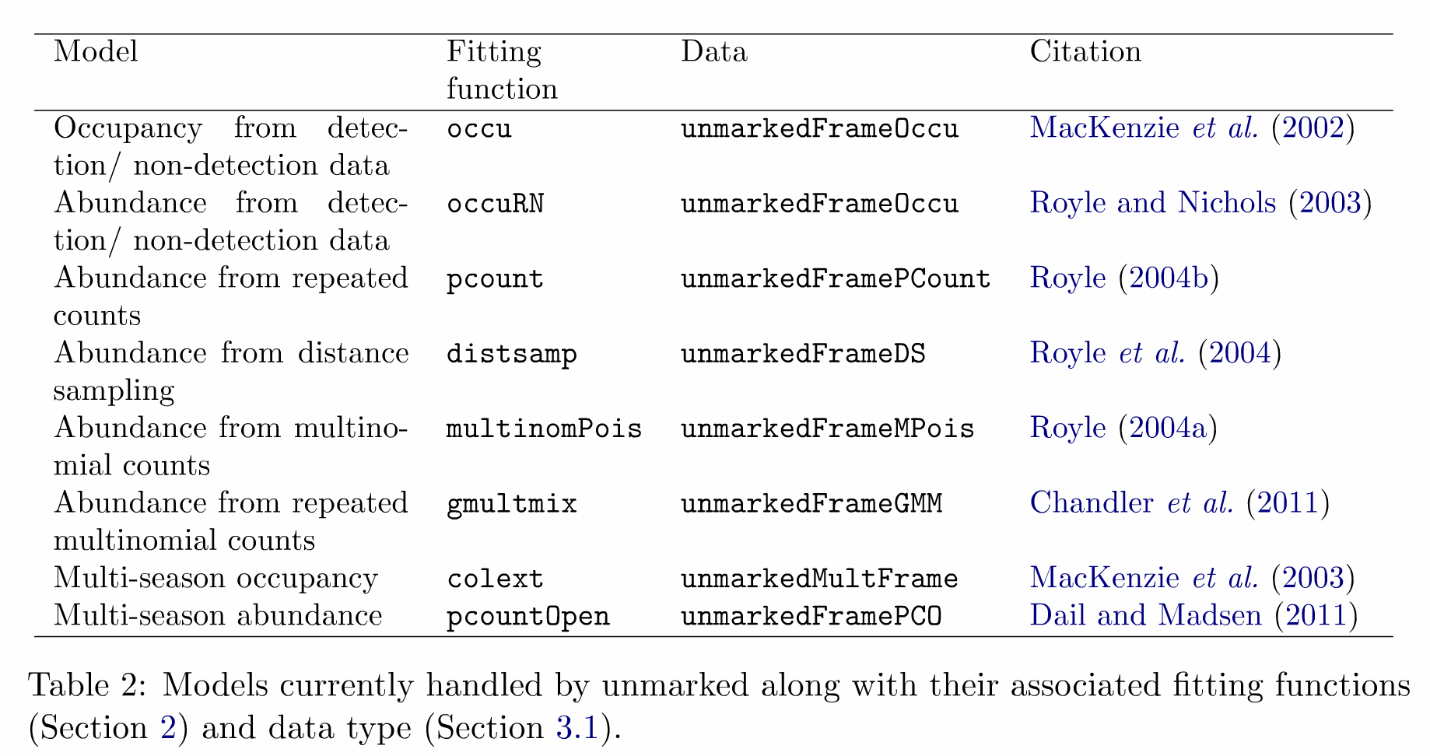
Which model should I use (unmarked)?

Slide 33

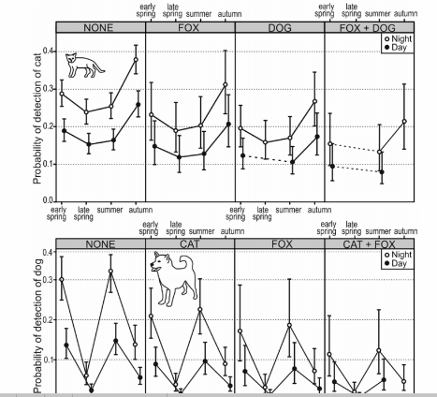
How do I use occupancy?

Slide 34

Resources
D.I. MacKenzie, J.D. Nichols, J.A. Royle, K.H. Pollock, L.L. Bailey, and J.E. Hines. 2006. Occupancy estimation and modeling. Academic Press. Burlington, MA.
D. I. MacKenzie, J. D. Nichols, J. E. Hines, M.G. Knutson, and A.B. Franklin. 2003. Estimating site occupancy, colonization, and local extinction when a species is detected imperfectly. Ecology 84:2200-2207.
Barbraud, C. , J. D. Nichols, J. E. Hines, and H. Hafner. 2003. Estimating rates of local extinction and colonization in colonial species and an extension to the metapopulation and community levels. – Oikos 101: 113–126.

